Slide 1

Our Next Unit…
Personality

Slide 2
What is personality?
An individual’s characteristic pattern of thinking, feeling, and acting
Used to explain
  Consistency
  Distinctiveness

Slide 3
Personality: The Big Five
Key Questions:
  How would a psychologist describe your personality?
  What “tools” do psychologists use when identifying an individual’s personality traits?

Slide 4
The Big Five:
Five Factor Model of Personality
Most personality traits are derived from just five higher-order traits, known as the “Big Five”
Neuroticism
Extraversion
Openness to experience
Agreeableness
Conscientiousness

Slide 5
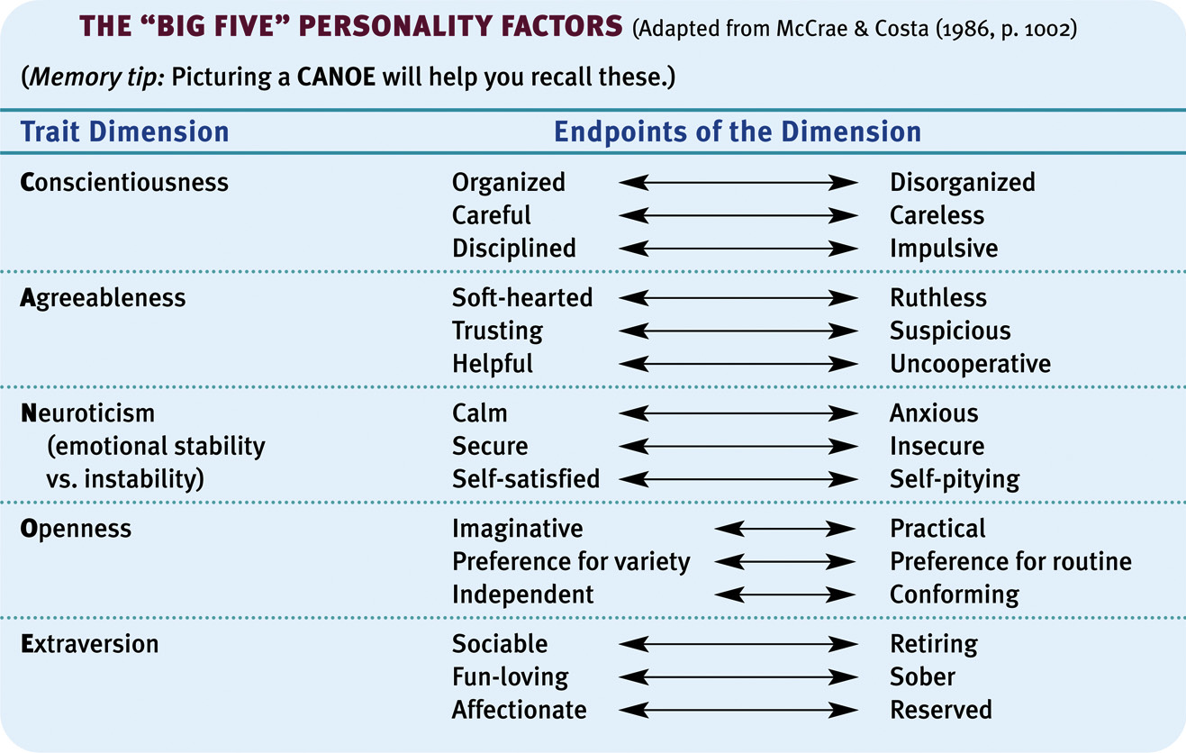

Slide 6
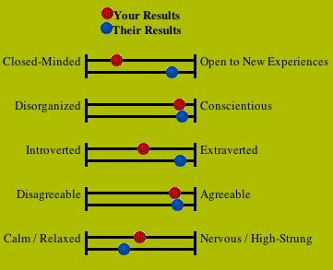
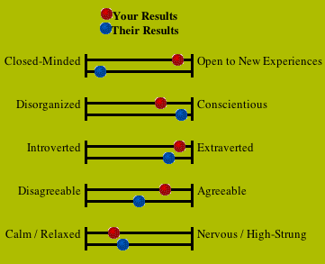
My Big 5 Survey
Tara’s Big 5 Survey

Slide 7
Criticisms of the Big Five
Just descriptive and provide no insight into the CAUSES of personality
Arbitrary model
Five traits is not enough
Five traits is too many

Slide 8
Scoring the Big Five
Note: R= Reverse the score (1 becomes a 5, 2=4, 3=3, 4=2, 5=1)
Add up 1, 6R, 11, 16, 21R, 26, 31R, 36
Add up 2R, 7, 12R, 17, 22, 27R, 32, 37R, 42
Add up 3, 8R, 13, 18R, 23R, 28, 33, 38, 43R
Add up 4, 9R, 14, 19, 24R, 29, 34R, 39
Add up 5, 10, 15, 20, 25, 30, 35R, 40, 41R, 44

Slide 9
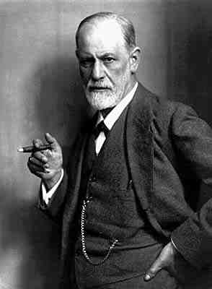
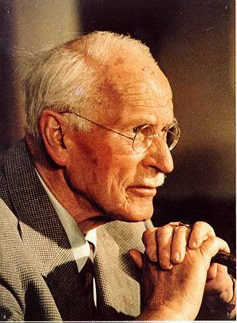
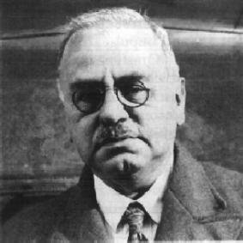
PSYCHOANALYTIC THEORY
Tries to explain personality, motivation, psychological disorders by studying childhood experiences and unconscious
  Sigmund Freud, Carl Jung and Alfred Adler

Slide 10
Levels of Awareness
Conscious
Preconscious
Unconscious
  Thoughts, memories and desires that are well below the surface of conscious awareness, but nonetheless exert great influence on personality

Slide 11


Structure of Personality
A person's personality is the outcome of interactions among three components:
Id: pleasure principle, instinctive component; wants immediate gratification of urges, “Devil”
Superego: moral component, right vs wrong, “Angel”
Ego: , realistic, practical, decision-making component, “Mediator”

Slide 12
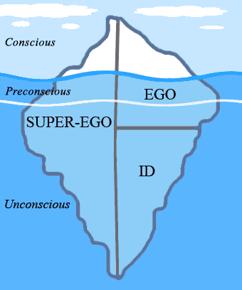
Iceberg Conception of the Mind

Slide 13
Freud’s Theory of Personality
Personality determined by internal conflicts among id, superego, and ego
  If id out of control, we make bad decisions
  If superego out of control, we are consumed by guilt
A healthy personality is dominated by the ego

Slide 14
Freud and the Cat in the Hat
The characters:
  The narrator and Sally
  The Cat
  The Fish
  The Mother
  Thing 1 & 2
What part of the personality you think Dr. Seuss wanted each character to represent?
  At the beginning?
  Middle?
  End?

Slide 15
Group Activity
Everyone has an index card. You will be assigned to write down a situation in which personality is being dominated by the ID, EGO, or SUPEREGO.
We will break off into groups and have a Freudian ID-off!

Slide 16
Key Questions: Defense Mechanisms
How do we think, feel and behave when we are stressed? How and why do we use defense mechanisms in these situations?
How do defense mechanisms help us? Hurt us?
“Just as the body unconsciously defends itself against disease, so does the Ego unconsciously defend itself from anxiety”
- Sigmund Freud

Slide 17
Defense Mechanisms and Personality
According to Freud, unconscious conflicts among the id, ego and superego create conscious anxiety or guilt
People try to get rid of these unpleasant emotions through defense mechanisms

Slide 18

Common Examples of
Defense Mechanisms
Rationalization: creating false but believable excuses to justify unacceptable behavior
Repression: keeping distressing thoughts buried in the unconscious
Projection: Accusing others of acting the same way you do

Slide 19

Common Examples of
Defense Mechanisms
Displacement: Taking out your emotional feelings (anger) on an innocent person
Reaction formation: behaving in a way that is opposite of one's true feelings
Regression: reversion to immature patterns of behavior

Slide 20


Common Examples of
Defense Mechanisms
Identification: boosting self esteem by forming an imaginary or real alliance with some person or group
Compensation: Attempt to make up for a lack of achievement in one area by pursuing another
Fantasy: daydreaming or imagining oneself engaging in some frustrated behavior

Slide 21
Common Examples of
Defense Mechanisms
Denial: ignoring the truth b/c it is too painful to accept
Selective inattention: “forgetting” to do something
Sublimation: acting out our unacceptable feelings in an acceptable way
Procrastination

Slide 22
Defense Mechanisms Wrap-up
How might defense mechanisms be helpful? Hurtful?
How can awareness of defense mechanisms lead to healthy personalities?

Slide 23
Criticisms of Freud
Poor testability
Depends too much on case studies.
  Clinicians see what they want to see
  Freud distorted patient's case histories to make them mesh with his theory
Sexist bias against women
  Females should feel inferior to men
  Females have weaker superegos

Slide 24
Freud’s Psychosexual Stages of Personality Development
Key Questions:
How (and WHY) does Freud use childhood sexual energies to explain personality development?
According to Freud, how do we develop healthy personalities?

Slide 25

“The Child is Father to the Man”
What did Freud mean by this?
  Basic foundations for personality have been laid down by age 5
  Our personality is influenced by our childhood and controlling the id

Slide 26
Freud’s Psychosexual Stages
In each stage the id presents unique developmental challenges: the we deal with these challenges shapes personality
  Common theme: fixation
    Lingering pleasure-seeking energies in a particular stage
    Development stalls due to either excessive gratification or excessive frustration
  Fixations left over from childhood affect adult personality

Slide 27
Psychosexual Stages of Development
Oral Stage (0-2 yrs)
  Key Task: Weaning from mother to bottle
  Fixation in the oral stage could lead to obsessive eating, smoking, or dependence on others later in life
Anal Stage (2-3)
  Key Task: Toilet Training
  Toilet training is society's first attempt to control child's biological urges
  Fixation: Anxiety/punishment associated with toilet training could lead to anal expulsive personality (sloppy, disorganized) or anal compulsive personality (excessively clean and orderly)

Slide 28
Psychosexual Stages of Development
Phallic Stage (4-5)
  Key Task: Coping with Oedipus Complex (Attraction to one parent; hostility towards the other)
  Healthy personality requires a resolution of the Oedipus Complex and no fixation
Latency Stage (6-12)
  Key Task: Expanding social contacts
Genital Stage (Puberty +)
  Key Task: Establish intimate relationships; contribute to society through work

Slide 29
Freud’s Psychosexual Stages
Wrap-up
Fixations in any stage lead to personality “issues”
Healthy personalities must avoid fixations

