Slide 1
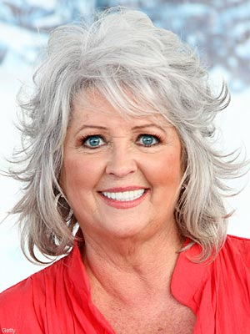
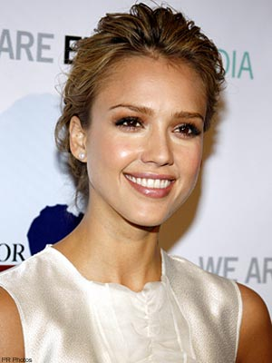
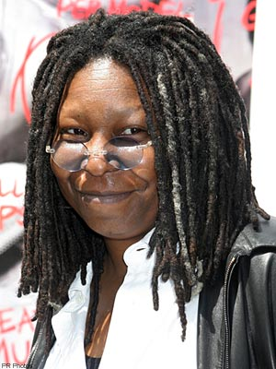


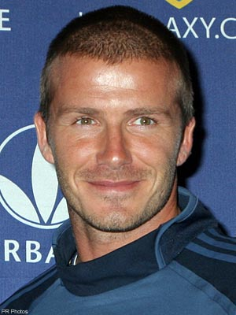
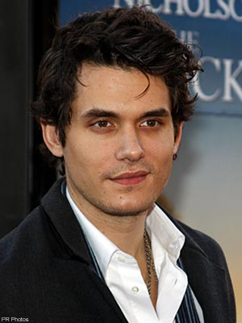
Anxiety Disorders

Slide 2
Anxiety Disorders:
Key Questions and Topics
How are anxiety disorders different than ordinary worries and fears we all experience?
How can we help?

Slide 3
Think about a time you felt anxiety in a social situation:
Describe…
  The physical symptoms
  The thoughts going through your head
  Your emotions

Slide 4

What are Anxiety Disorders?
Class of disorders marked by feelings of excessive apprehension and anxiety
  Affect 17% of the population!

Slide 5
Watch
“Afraid of People”
Based on the video, make a list:
Anxiety disorders…
Look like | Feel like

Slide 6
Social Anxiety Disorder/
Social Phobia
"In any social situation, I felt fear. I would be anxious before I even left the house, and it would escalate as I got closer to a college class, a party, or whatever. I would feel sick at my stomach—it almost felt like I had the flu. My heart would pound, my palms would get sweaty, and I would get this feeling of being removed from myself and from everybody else.”
http://www.nimh.nih.gov/publicat/anxiety.cfm#anx5
Persistent anxiety in social situations, usually motivated by fear of embarrassment
Symptoms:
  trembling, sweating, blushing, high blood pressure
Prevalence: 7% (equal in males & females)

Slide 7
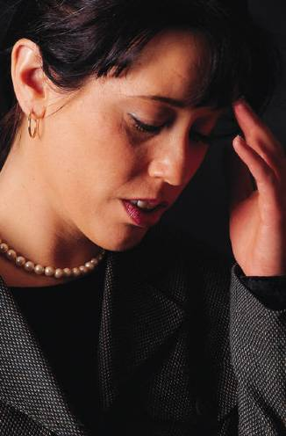
Generalized Anxiety Disorder
Substantial (> 6 months) period of unexplainable anxiety and worry
  “Worry about yesterday’s mistakes and tomorrow’s problems”
Symptoms:
  muscle tension
  Easily fatigued
  poor concentration
  Insomnia
  Irritability
Prevalence: 3% (2:1 women)

Slide 8
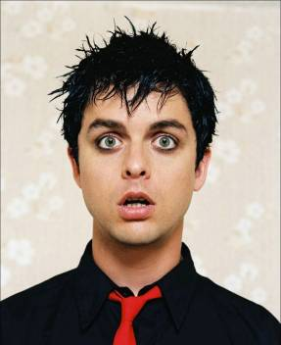
Panic Attacks/Disorder
Recurrent episodes of overwhelming anxiety and intense fear that usually occur suddenly and unexpectedly
  Heart palpitations, shortness of breath, choking sensations, trembling, dizziness
  Often misperceived as a heart attack
May result in or exacerbate agoraphobia or social phobia

Slide 9
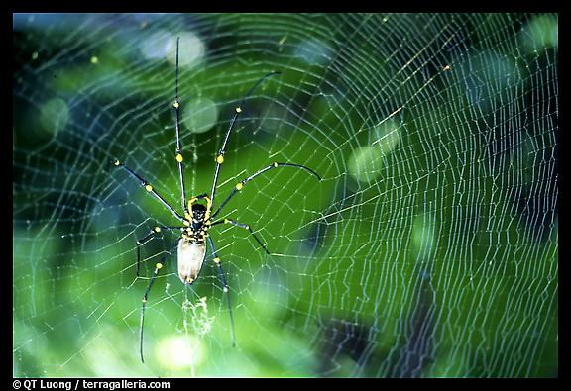
Phobias
Irrational fear of a specific object or situation that poses no realistic danger
How are phobias different from everyday fears?
Where do they come from?
How can phobias be treated?
Prevalence: >10% of the population has some sort of phobia

Slide 10
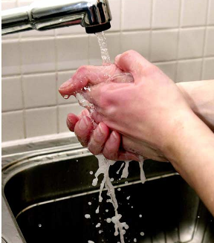
Obsessive-Compulsive Disorder
Obsessions - recurrent, intrusive thoughts, impulses, or images
Compulsions - repetitive behaviors or mental acts that reduce the anxiety that accompanies an obsession
Symptoms:
  frequent hand washing
  Irrational need for order/cleanliness
  Repetitive behavior
Prevalence: 2%

Slide 11
I was raped when I was 25 years old. For a long time, I spoke about the rape as though it was something that happened to someone else. I was very aware that it had happened to me, but there was just no feeling.
Then I started having flashbacks. They kind of came over me like a splash of water. I would be terrified. Suddenly I was reliving the rape. Every instant was startling. I wasn’t aware of anything around me, I was in a bubble, just kind of floating. And it was scary. Having a flashback can wring you out.
The rape happened the week before Thanksgiving, and I can’t believe the anxiety and fear I feel every year around the anniversary date. It’s as though I’ve seen a werewolf. I can’t relax, can’t sleep, don’t want to be with anyone. I wonder whether I’ll ever be free of this terrible problem.

Slide 12
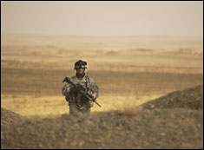
Post-Traumatic Stress Disorder
Development of anxiety after exposure to extreme trauma
What factors trigger PTSD?
  Accidents
  War
  Rape
  Genetics?
Prevalence: 4%
(women twice as likely
as men)
Nurture
Nature

Slide 13
PTSD
Symptoms:
  May startle easily,
  Emotionally numb
  Lose interest in things they used to enjoy,
  Trouble feeling affectionate
  Easily irritable
  Become more aggressive, or even violent.
  Avoid situations that remind them of the original incident
  Flashbacks
    believe that the traumatic incident is happening all over again.

Slide 14
PTSD and War
How can we best support and help persons with PTSD?
  Government?
  Society?
  Families and friends?

Slide 15
Wrap-up
How are anxiety disorders different than ordinary worries and fears we all experience?
How can we help?

